Slide 1
Introduction to C++ programming

Slide 2
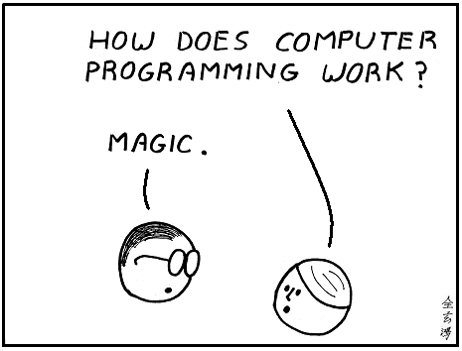
Computer programming ?

Slide 3
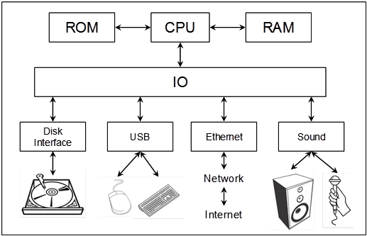
Overview of computer hardware

Slide 4
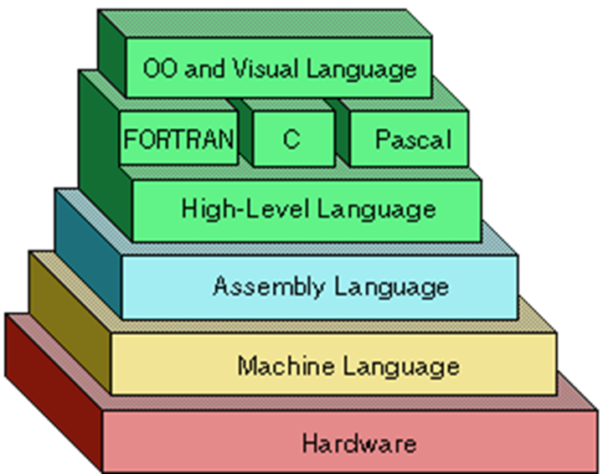
Layers of Computer programming

Slide 5
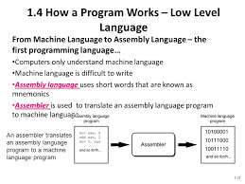
Low Level Programming Language

Slide 6
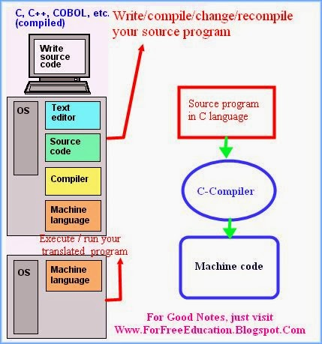
Steps of Programming

Slide 7
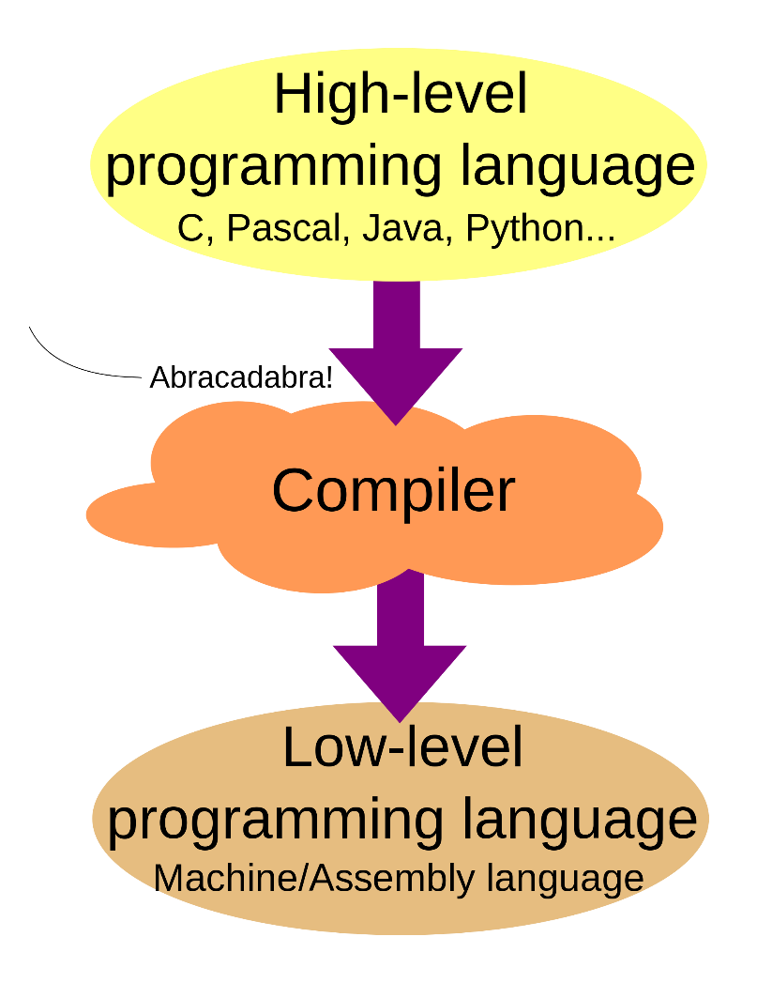
Steps Programming

Slide 8
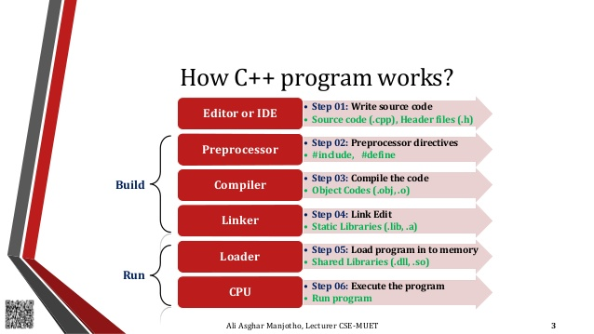
C++ Development Workflow

Slide 9
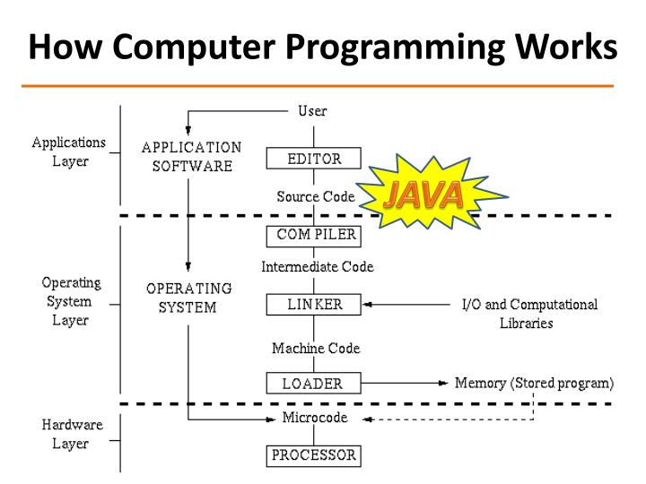
Java Development Workflow

Slide 10
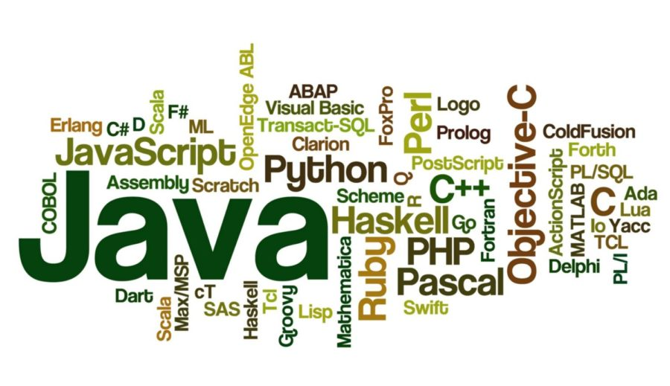
Zoo of Programming Language

Slide 11
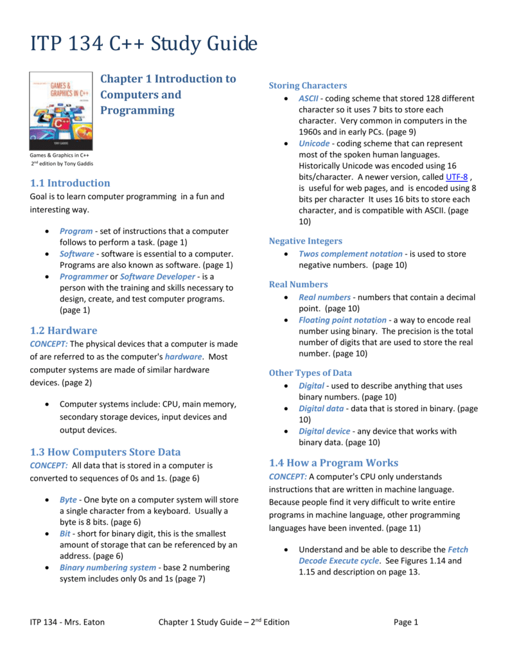

Slide 12
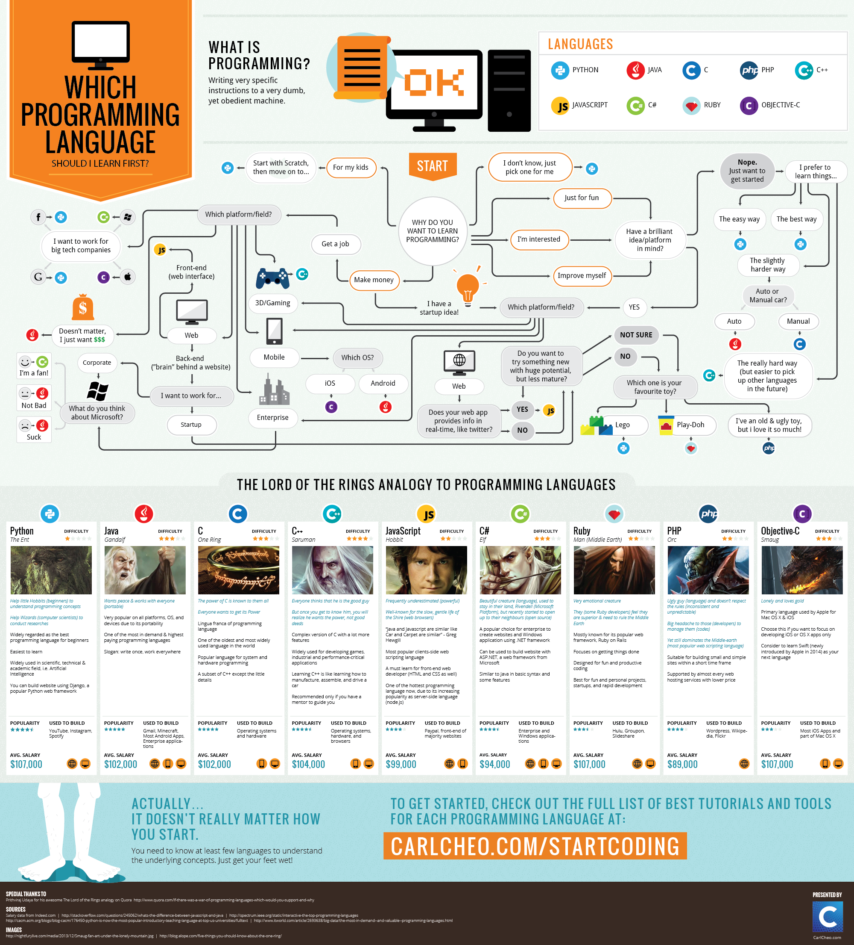

Slide 13
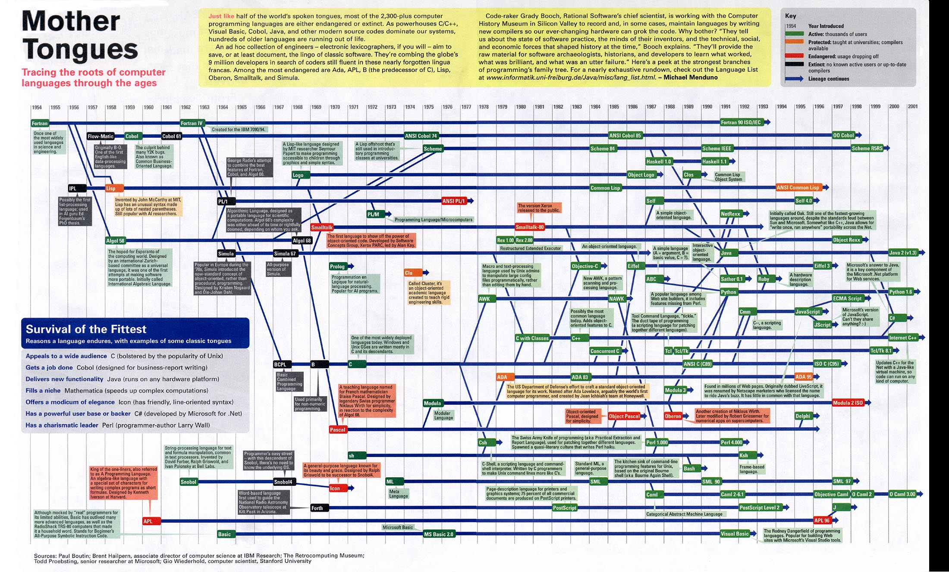

Slide 14
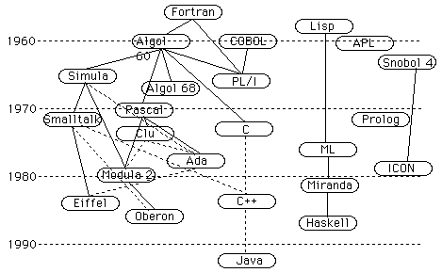

Slide 15
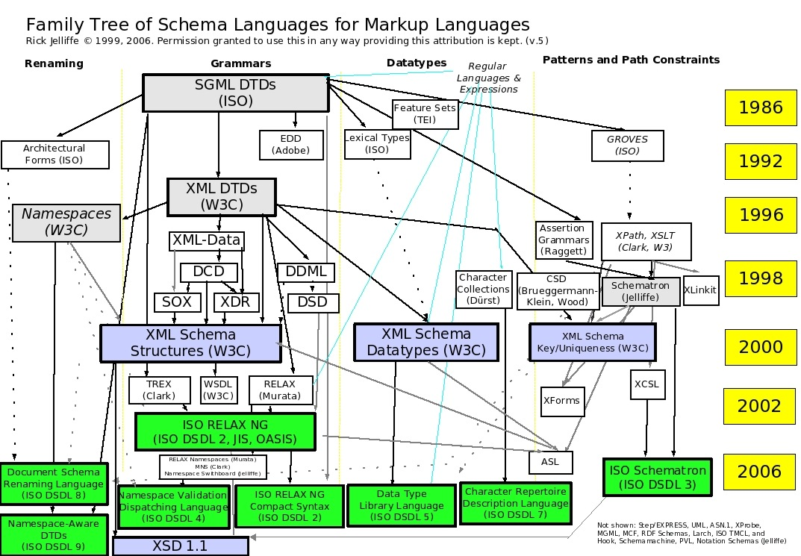

Slide 16
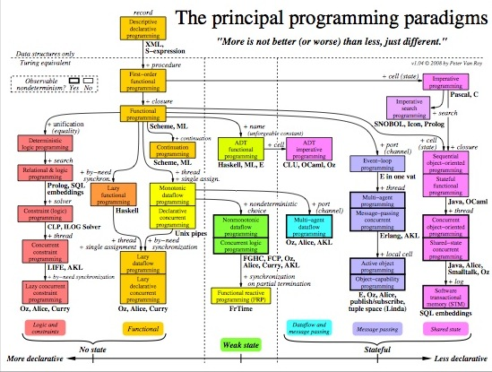

Slide 17
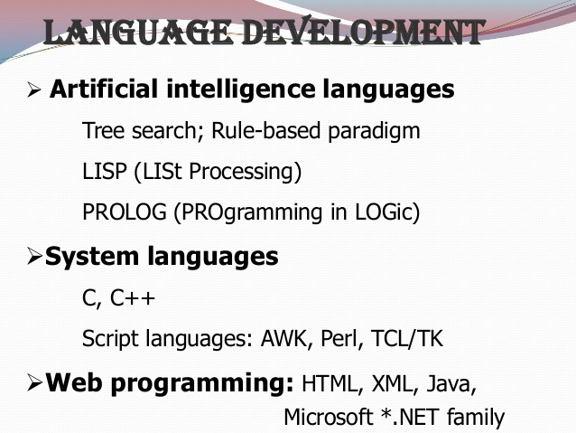

Slide 18
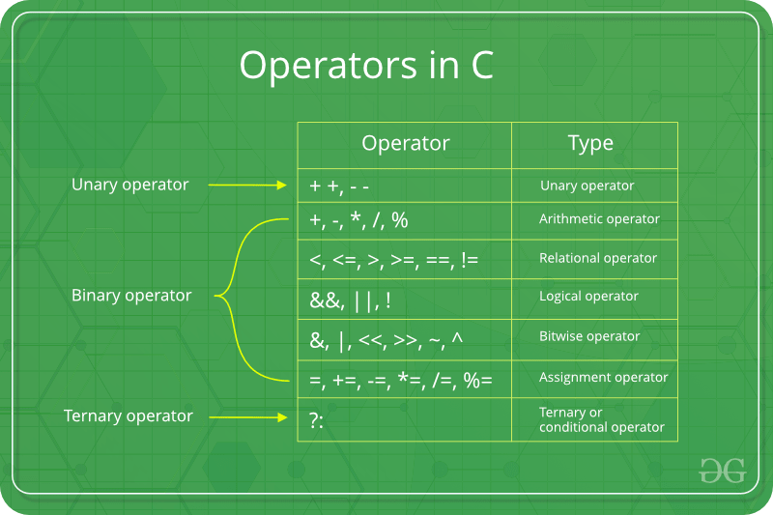

Slide 19
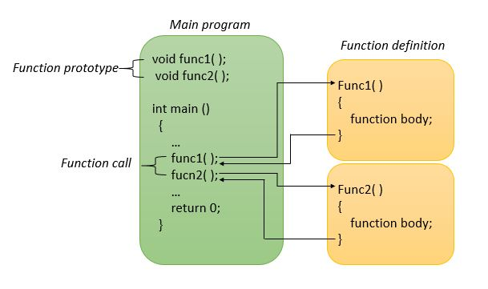

Slide 20
IDE or Text Editors for c++
Vim
Clion
Eclipse
VS Code

Slide 21
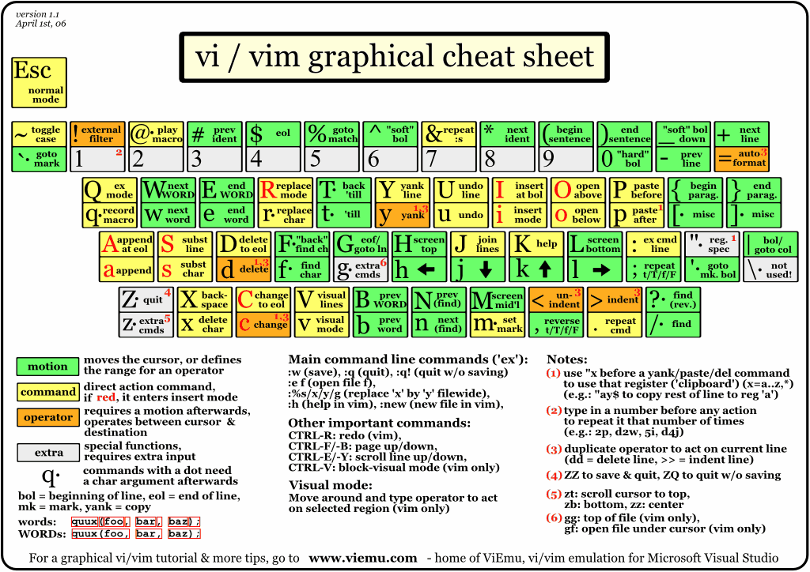
VIM Crash Course

Slide 22
Compilers
g++
Apple C++
Clang C++
http://www.stroustrup.com/compilers.html

Slide 23
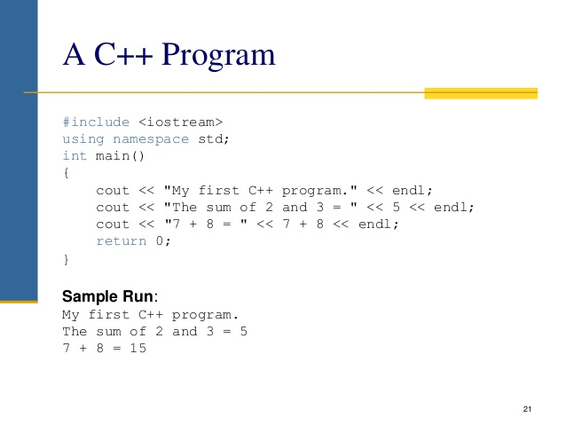
First C++ Program

Slide 24
Building blocks of C++
Comments: // for line comments
/ * <comments> */
// comments till end of line
#includes:
#include <iostream>
Main function:
Where program starts

Slide 25
Variables
Syntax for declaring variables:
<data_type> <variable_name> = <value>;
E.g.: int index = 0;
Data Types:
int: could have unsigned int, long, long long
char: could have unsigned char
bool
float
double

Slide 26
Variables
Variable Name
Consists of _, alphabet(a-z, A-Z), numerical (0-9)
Can only start with _ or alphabet(a-z, A-Z)
Conventions:
Camel Case: leastNumericValue
Snake: least_numeric_value
Case sensitive:
Least_numeric_value not the same as least_numeric_value
Scope
Local scope
Global scope
Function scope

Slide 27
Variable
Life
Local variable ends life when exiting their scope
Global variable leaves throughout the life of the program
Global Variable #include <iostream> using namespace std; // This is a global variable char myVar = 'A'; int main() { cout <<"Value of myVar: "<< myVar<<endl; myVar='Z'; cout <<"Value of myVar: "<< myVar; return 0; }

Slide 28
Local Varaibles
char myFuncn() {
// This is a local variable
char myVar = 'A';
}

Slide 29
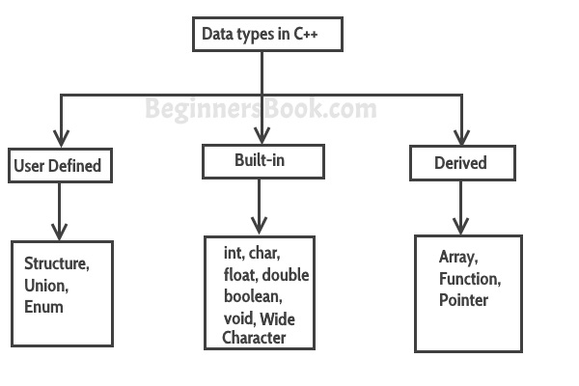
Data Type
Data types in C++ are categorised in three groups: Built-in, user-defined and Derived.

Slide 30
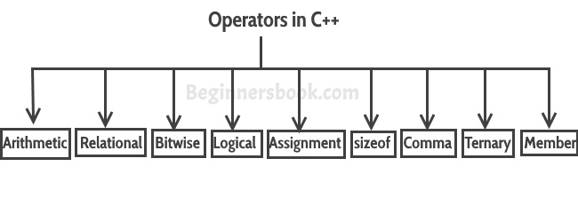
Operations

Slide 31
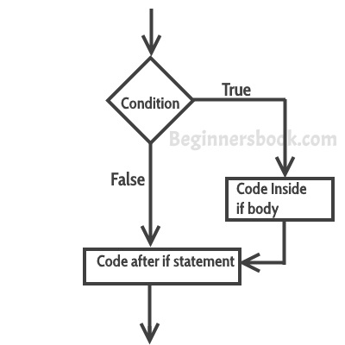
Flow Control (if … else if … else …)

Slide 32
Switch statement
switch (variable or an integer expression)
{
case constant:
//C++ code
;
case constant:
//C++ code
;
default:
//C++ code
;
}

Slide 33
For loop

Slide 34
While loop

Slide 35
Do .. while

Slide 36
Continue/break statements

Slide 37
Function
Syntax of Function
return_type function_name (parameter_list)
{
//C++ Statements
}
Let’s take a simple example to understand this concept.

Slide 38
Recursion
A function calls itself

